Slide 1


Co-creation
Anastas Mishev
https://orcid.org/0000-0001-7271-6655

Slide 2
Agenda
Incremental changes
Feedback analysis
Continuous improvement

Slide 3
Incremental changes
A regular analysis of all QA aspects is necessary to identify potential elements for improvement.
Based on the feedback analysis, a plan should be made for the development of a new version of the learning materials.

Slide 4
Feedback analysis
Feedback from the learners and from the instructors
Sources
feedback form
direct email contact
external Quality Assurance
comments
GitHub issues or discussion
self-reflection
The result: a list of potential improvements, each marked with an impact level (high, moderate, low).

Slide 5
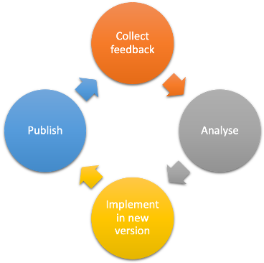
Continuous improvement

Slide 6
Which of the following are elements of the Continuous Improvement cycle
Collect feedback
Analyse
Signpost
Publish

Slide 7
Summary
Incremental changes
Feedback
Continuous improvement

Slide 8
Thank you! Any questions?
sonja.filiposka@finki.ukim.mk

